Slide 1


GARLIC NAAN
SE LAB PROJECT
CTMS
BY:- GAURANG GUPTA ,
VAASU SINGLA,
ARUDEEP KUMAR

Slide 2

Table of
CONTENTS
01
02
03
04
OUR TEAM
PROBLEM DOMAIN DESCRIPTION
Technical Details
Use Cases
05
Challenges Faced

Slide 3
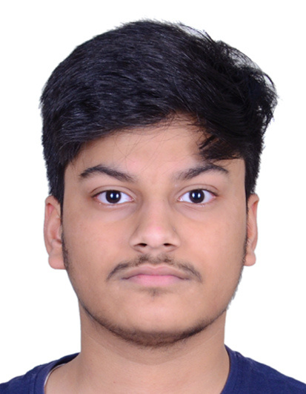

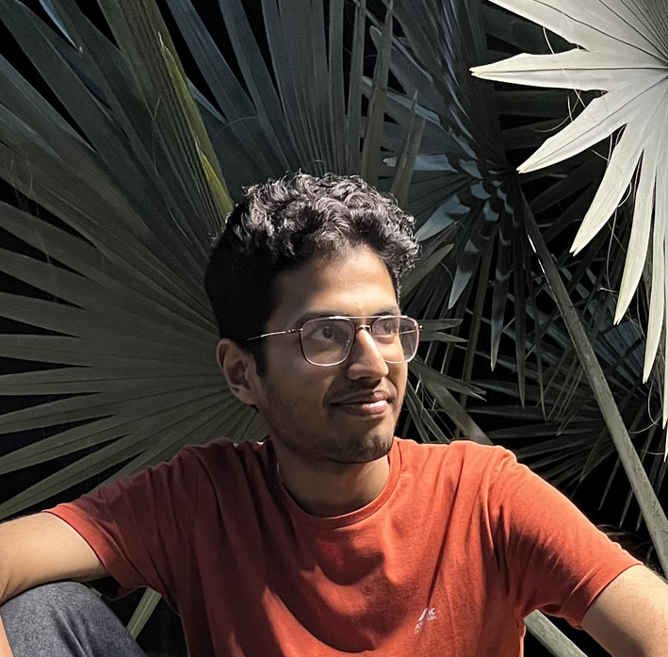
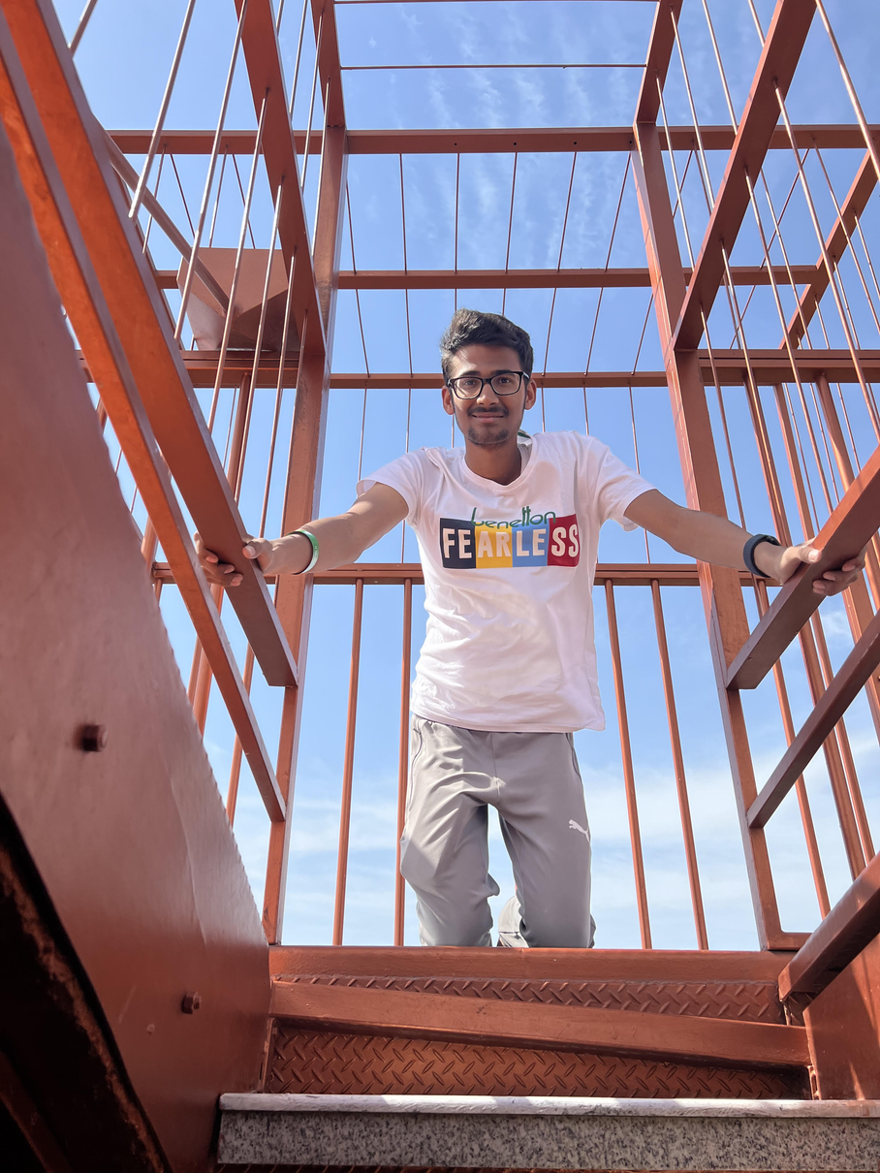

Meet
THE TEAM
GAURANG GUPTA
VAASU SINGLA
ARUDEEP KUMAR
Linking ,Backend
Backend
Frontend

Slide 4

PROBLEM
DESCRIPTION
The purpose of the Cricket Tournament Management System (CTMS) project is to develop a comprehensive software solution for managing and storing data related to cricket tournaments, such as the Indian Premier League (IPL) or the Cricket World Cup.
The Cricket Tournament Management System (CTMS) is envisioned as a comprehensive tool
designed to automate and streamline the management of cricket tournaments, reminiscent of
globally recognized formats like the Indian Premier League (IPL) or the ICC Cricket World Cup. By
integrating detailed management of players, teams, and match statistics into a single platform, the
CTMS provides a holistic view of tournament operations, significantly reducing the manual effort
involved in such endeavors.

Slide 5

Operating Environment
Technical
The Cricket Tournament Management System is a web-based application compatible with modern web browsers such as Google Chrome, Mozilla Firefox, and Microsoft Edge.
It is compatible with MAC Os
DETAILS
FRAMEWORK USED
The CTMS is built using the Flask framework for Python
DATABASE
CTMS utilizes a SQLite database for data storage and management

Slide 6
Use cases
01
randomly generate player and team details
02
generating random match schedule. Each team faces all other teams exactly once
03
for a particular match whose details are not yet generated, generate random match details
04
complete player statistics including runs, strike rate, average, and wickets taken and its personal details like name, age

Slide 7
Use cases
05
View team’s statistics. This include matches played, matches won, highest run scorer. highest wicket taker
06
View a match’s scorecard, and mark the already generated once
07
View the tournament statistics, 5 highest run scorers and wicket takers

Slide 8


Challenges
FACED
Making a web application with both frontend and backend involved learning HTML, CSS for frontend and flask for backend. We faced problems while linking frontend with backend.
Database management was a tremendous task, we learnt and used Sqlite for the first time, involving updating database using sql queries and fetching data at appropriate places was a challenge. We were unsure on how to connect sqlite code with python code.

Slide 9
Challenges
FACED
Implementing certain functionalities was a big challenge.
Adding picture paths in the database and calling them to insert picture.
Randomly generating data which involves shuffling players in teams and assigning roles to the players and maintaining all that correctly in the database in multiple tables.
Randomly generating match data and .updating the corresponding data in all the tables.
Creating a dynamic HTML page where every tab a tab is being clicked, data is being fetched from the database and displayed on the screen.

Slide 10
THANK YOU

